Slide 1




Bank Loan of Customers P235(Bank Analytics)
GROUP NO.: 4
GROUP MEMBERS:
Anjali Patnaik
Sundar N
Swati Vithoba Patil
Yamini L
Ravali Pulluri
Abhay Baburam Yadav

Slide 2
Agenda
Project Objective
Contents
Dashboard & KPI’S Insight
Challenges & Scale up Business
Summary

Slide 3

Project Objective
The objective is to ensure that loans provided by the bank are made on appropriate terms to the customers who can and will pay them back in order to have a growth.
We used Power Query, Power Pivot & MySQL for analyzing, cleaning and removing duplicates from dataset and prepared dashboard using MS Excel, Tableau and PowerBI tools where we did calculations, create relationships and prepared interactive dashboards.
3

Slide 4


Contents
Created Dashboard showing the below KPI’S & the insight:
KPI-1 : Year wise loan amount Stats
KPI-2 : Grade and sub grade wise revol_bal
KPI-3 : Total Payment for Verified Status Vs Total Payment for Non Verified Status
KPI-4 : State wise and last_credit_pull_d wise loan status
KPI-5 : Home ownership Vs last payment date stats
KPI’S

Slide 5
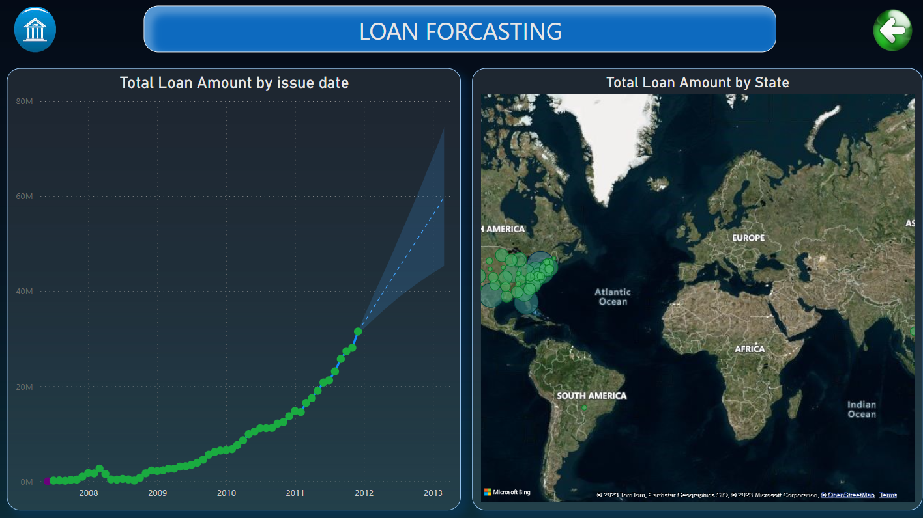
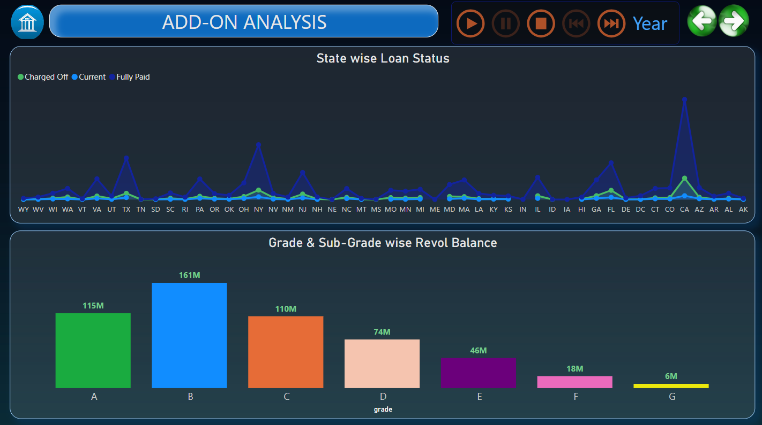
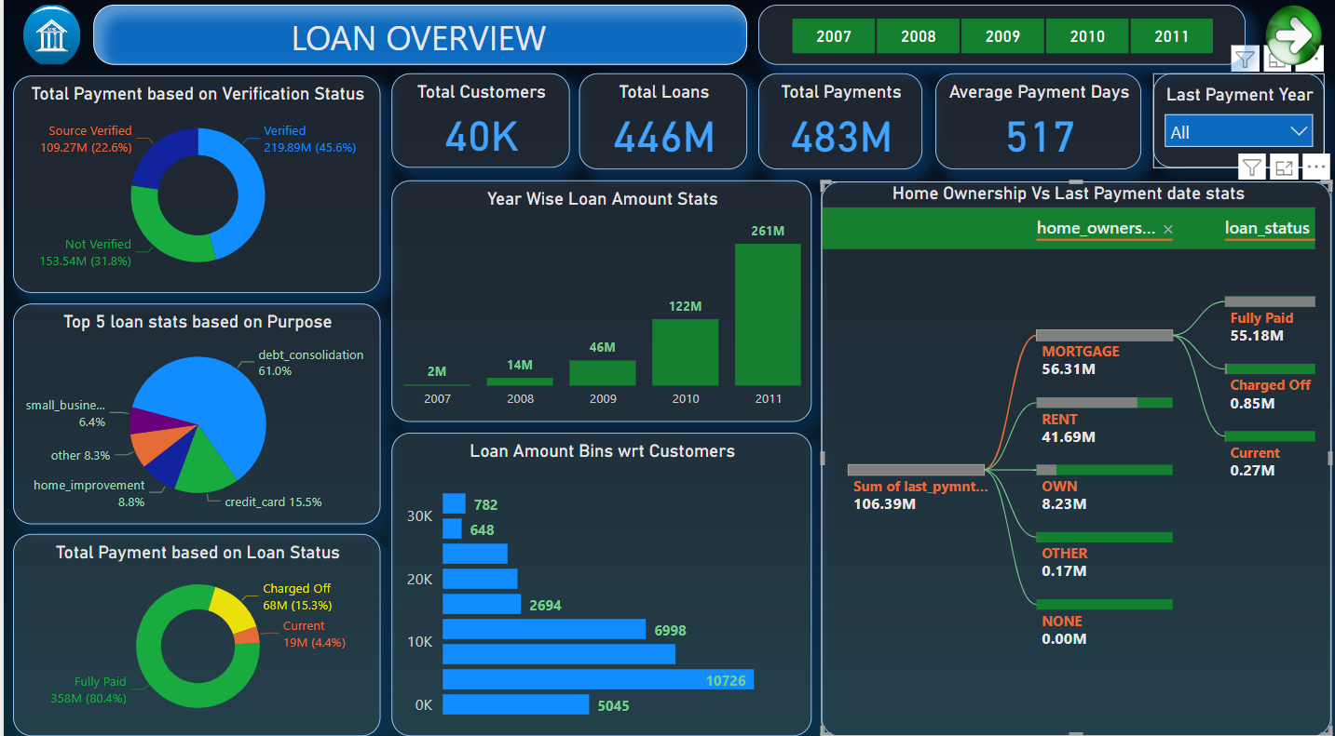
Power BI Dashboard
5

Slide 6
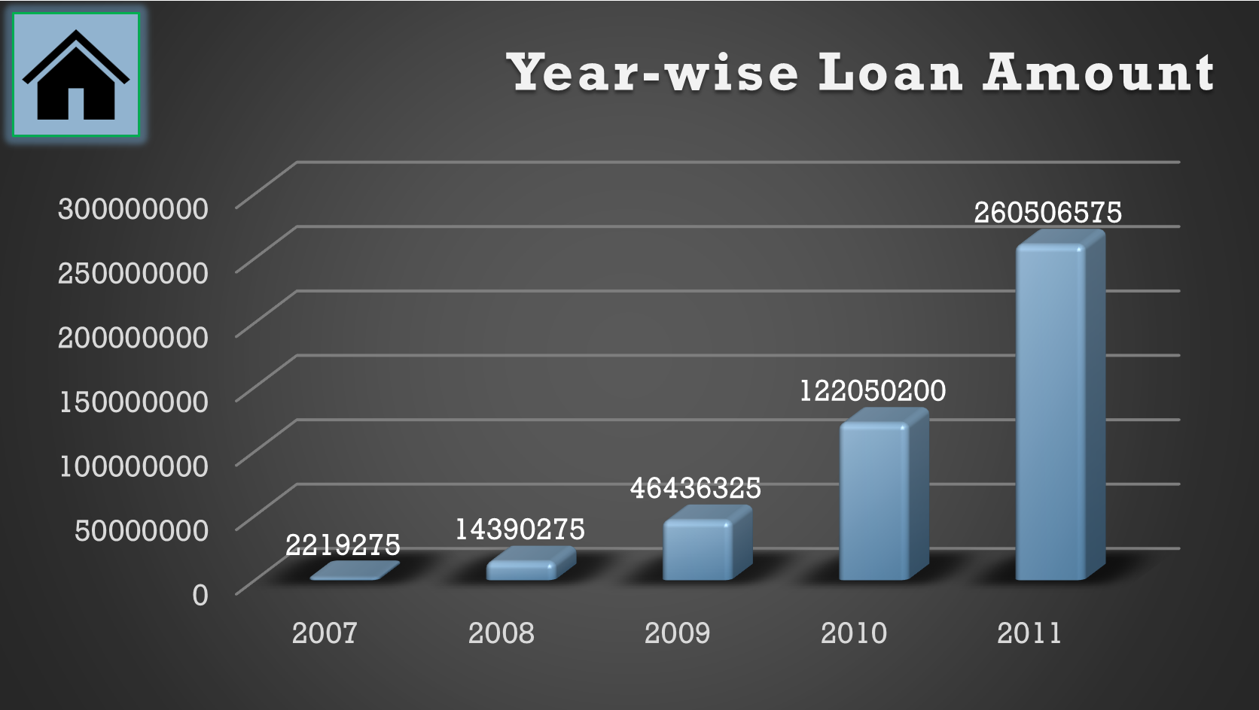
KPI 1
Year Wise Loan Amount Stats:
The chart provides a details of all Loan issued by the bank through 2007-2011
Total loans issued was reported at 26,05,06,575 in the year 2011,this records an increase of 25,82,87,300 in the span of 4 years.
(26,05,06,575 – 22,19,275 = 25,82,87,300)
6

Slide 7
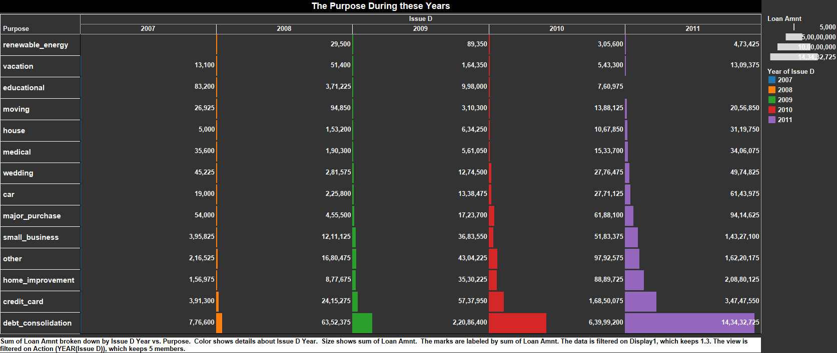
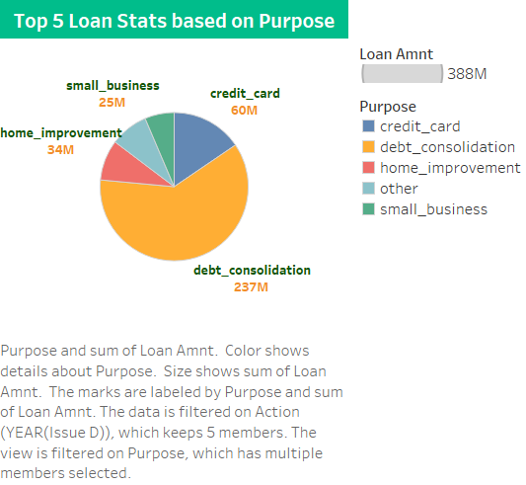
KPI 1 Sub Charts
Loan Stats based on Status:
7

Slide 8
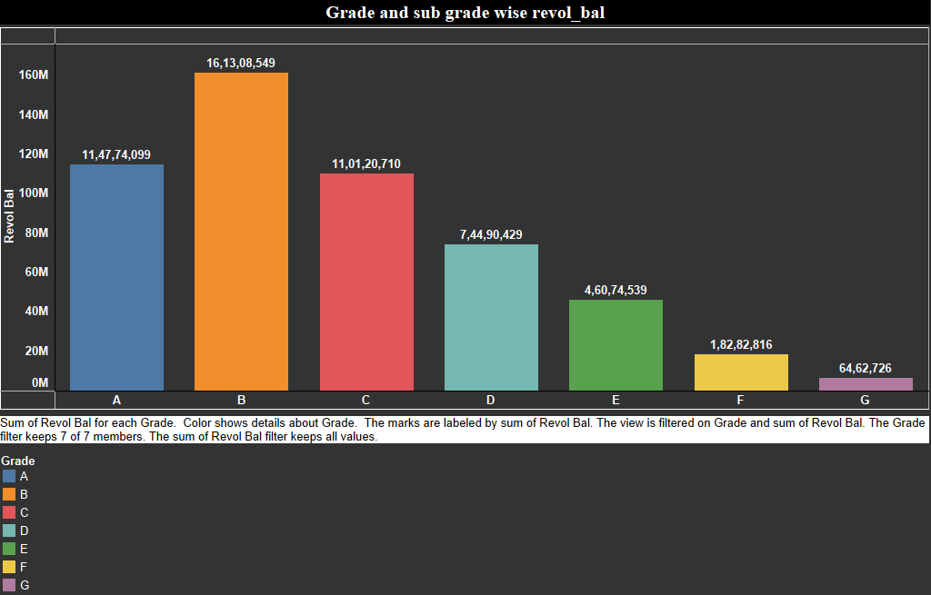
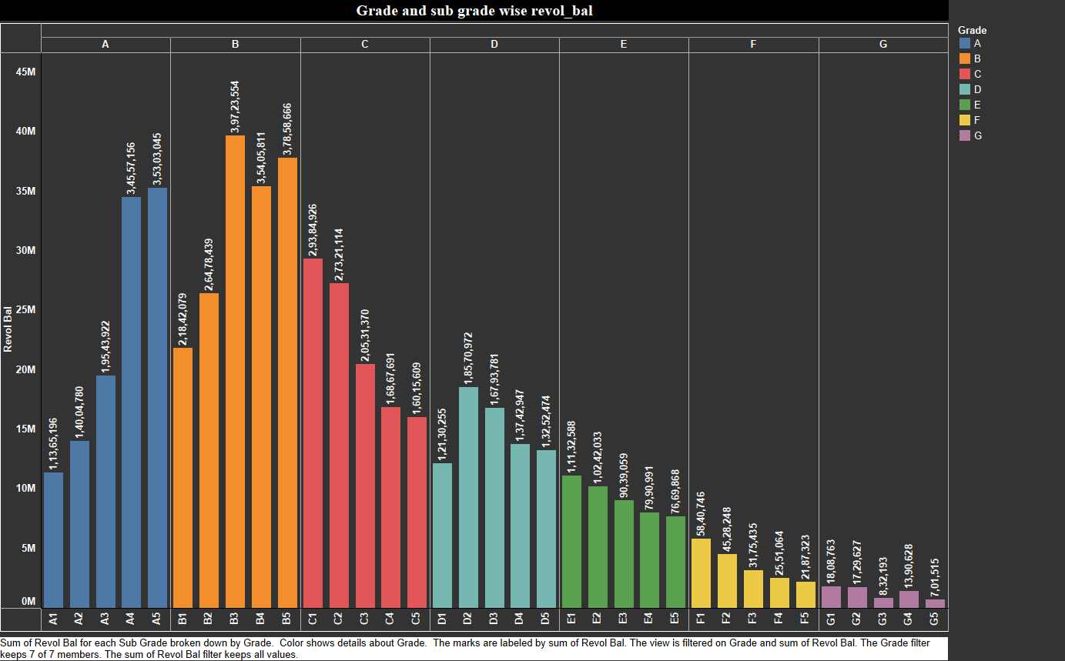
KPI 2
Grade & Sub Grade Wise Revol Balance:
This chart can help identify if there's a correlation between a borrower's credit quality and their revolving balance.
we can notice Grade-B have more revol balance then any other grade & Grade-G have very low revol balance.
8

Slide 9
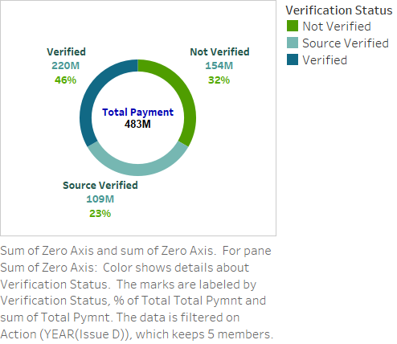
KPI 3
Total Payment based on Verification Status:
This is the first stage of the verification process. The bank needs a loan application to initiate the document collection and verification process.
It can provide insights into the impact of income verification on repayment behavior.
Looking at Donut & Pie chart we can observe that from Total payment of 483M,46% are verified, 32% Not Verified and 23% are Source Verified
9

Slide 10
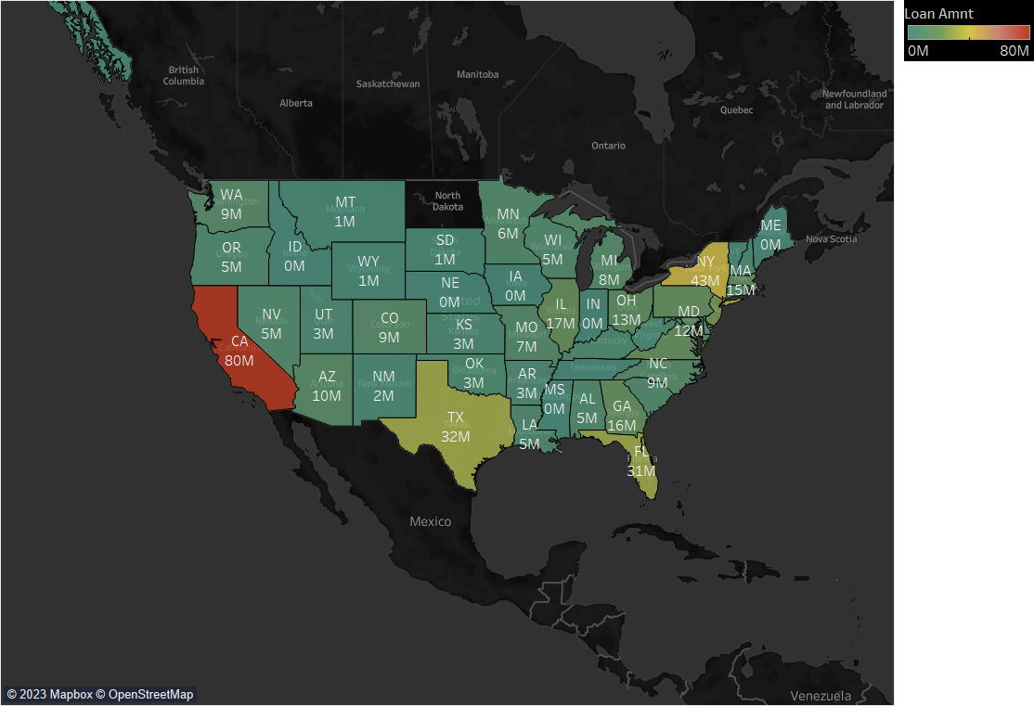
KPI 4
State wise and last_credit_pull_d wise loan Status:
This graph shows the count of Laon Status in each state based on particular last credit pull date .Provide insights into geographic payment behavior or trends.
As we can see CA has the maximum customers who took Loan 80M
California bags the highest in terms on loan amount and Washington has the highest average interest rate of 12.61%.
10

Slide 11
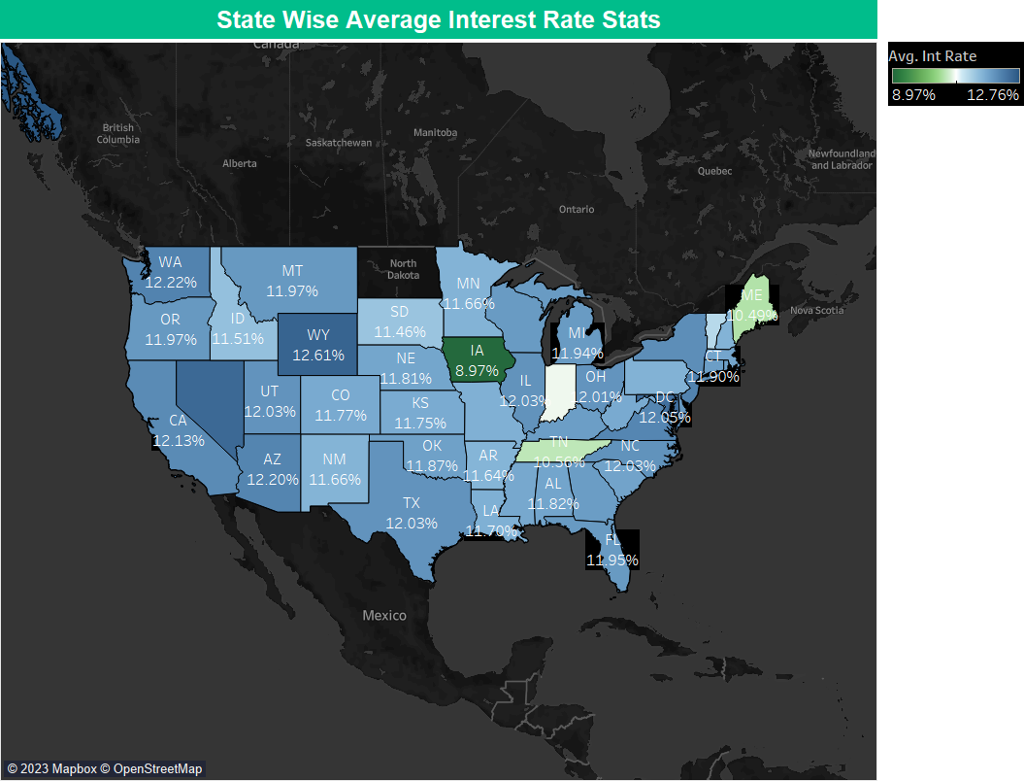
KPI 4 Sub Charts
State wise and last_credit_pull_d wise loan Status:
California bags the highest in terms on loan amount and Washington has the highest average interest rate of 12.61%.
11

Slide 12
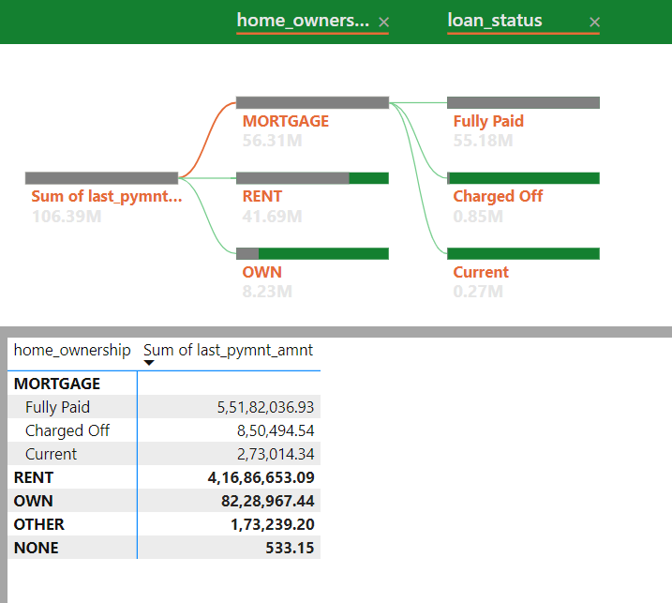
KPI 5
Home Ownership Vs Last Payment date Stats:
The right graph shows the Home ownership and the amount paid for each on last payment date.
Home Ownership(Mortgage) has received the largest payment of a total of 56.31M out of which 55.18M are Fully Paid.
It concludes that many of the customers are about to repay their loan amount for their particular home ownership.
12

Slide 13

Challenges
SQL- Unable to import the complete data of Finance_2 into SQL and also need to modify the date data types
Excel- Different results was showing based on merged data, VLOOKUP and creating relationship between 2 datasets
Power BI – Unable to delete Null values available in some of the date columns
Tableau- No Issues
We have created relationships between Finance_1 and Finance_2 data as weren’t able to get the proper results using the merged dataset
13

Slide 14



How we get there
Offer the Best Customer Experience
Consider search engine discovery, referrals and in-person exposure
Special offers for good repay masters.
Make improvements in your processes .e.g. smoother verification of income process, pre approval letter
Niche Markets
Develop lending specialties that cater to niche industries such as women owned businesses, government guaranteed finance
For entrepreneurs and businesses to fund their operations, expansion, or capital needs.
Special Programs
Expand your web presence and your social media efforts
Special offers on existing loans to improve interest rates or terms.
Special loan programs with favorable terms and rates for bank staff.
14

Slide 15

Summary
This study provides information on complete loan data for all loans issued through 2007-2011, including the current loan status(Current, Charged-off, Fully paid) and latest payment information. By analyzing different attributes/features of customer we can predict if a particular applicant will or will not be able to payback the loan amount .
15

Slide 16




Thank you

